Slide 1
TP2 sur SHACL
Used Ontology: movie ontology with instances
File BCVisuAll.ttl (to be downloaded from Google drive )
Warning: launch a reasonner before starting to work
Hermit
Install a new widget in Protégé: click when launching protégé or select SHACL4Protégé from
https://github.com/fekaputra/shacl-plugin
Then restart Protégé and select the widget in the menu windows/tabs/
More detailed course
https://moodle.polymtl.ca/course/view.php?id=30

Slide 2
SHACL: readings
The W3C recommendation
https://www.w3.org/TR/shacl/
An introduction to SHACL
http://book.validatingrdf.com/bookHtml011.html
About SHACL rules (further reading)
https://www.w3.org/TR/shacl-af/#rules

Slide 3
Standard for a constraint language
SHACL has been defined by a W3C Working Group and has become a widely used standard for
describing structural constraints on data graphs: SHACL vocabulary
validating RDF instance data against those: SHACL processors
2 parts in the vocabulary
SHACL-Core (SHACL) = basic vocabulary for constraint expression
SHACL-SPARQL = SHACL-Core plus the advanced features of SPARQL-based constraints and an extension mechanism to declare new constraint components.
In a nutshell, a SHACL processor takes a shapes graph and a data graph as input. Both can be entered here using data formats such as Turtle or JSON-LD. The shapes graph defines so-called shapes which are a collection of constraints. A shape also tells the engine for which nodes in the data graph it applies to (using targets). Constraints are of a type, called constraint components.
Name space sh = http://www.w3.org/ns/shacl#

Slide 4
What is SHACL useful for?
KG validation
To express constraints on KGs
To check the conformity of a knowledge graph with a set of contraints
KG instantiation
The set of contraints is used to generate forms and input data that fulfill the constraints
The KG graph can play the role of an ontology
Ontology representation ☹
Closed world hypothesis

Slide 5
Example of shape file (0)
Node shape
:UserShape a sh:NodeShape ;
sh:targetClass :User ;
sh:property [ # Blank node 1
sh:path schema:name ;
sh:minCount 1;
sh:maxCount 1;
sh:datatype xsd:string ; ] ;
sh:property [ # Blank node 2
sh:path schema:gender ;
sh:minCount 1;
sh:maxCount 1;
sh:or (
[ sh:in (schema:Male schema:Female) ]
[ sh:datatype xsd:string] ) ] ;
sh:property [ # Blank node 3
sh:path schema:birthDate ;
sh:maxCount 1;
sh:datatype xsd:date ; ] ;
sh:property [ # Blank node 4
sh:path schema:knows ;
sh:nodeKind sh:IRI ;
sh:class :User ; ] .
@prefix dash: <http://datashapes.org/dash#> .
@prefix rdf: <http://www.w3.org/1999/02/22-rdf-syntax-ns#> .
@prefix rdfs: <http://www.w3.org/2000/01/rdf-schema#> .
@prefix schema: <http://schema.org/> .
@prefix sh: <http://www.w3.org/ns/shacl#> .
@prefix xsd: <http://www.w3.org/2001/XMLSchema#> .
Property shape
( implicit
:Blanknode2 a sh:PropertyShape )

Slide 6
Example of shape file (1)
Class to declare a constraint
:UserShape a sh:NodeShape ;
sh:targetClass :User ;
sh:property [ # Blank node 1
sh:path schema:name ;
sh:minCount 1;
sh:maxCount 1;
sh:datatype xsd:string ; ] ;
sh:property [ # Blank node 2
sh:path schema:gender ;
sh:minCount 1;
sh:maxCount 1;
sh:or (
[ sh:in (schema:Male schema:Female) ]
[ sh:datatype xsd:string] ) ] ;
sh:property [ # Blank node 3
sh:path schema:birthDate ;
sh:maxCount 1;
sh:datatype xsd:date ; ] ;
sh:property [ # Blank node 4
sh:path schema:knows ;
sh:nodeKind sh:IRI ;
sh:class :User ; ] .
Rdf:Property that specifies the target class
Each property describes a part of the constraint

Slide 7
Example of shape file (2)
:UserShape a sh:NodeShape ;
sh:targetClass :User ;
sh:property [ # Blank node 1
sh:path schema:name ;
sh:minCount 1;
sh:maxCount 1;
sh:datatype xsd:string ; ] ;
sh:property [ # Blank node 2
sh:path schema:gender ;
sh:minCount 1;
sh:maxCount 1;
sh:or (
[ sh:in (schema:Male schema:Female) ]
[ sh:datatype xsd:string] ) ] ;
sh:property [ # Blank node 3
sh:path schema:birthDate ;
sh:maxCount 1;
sh:datatype xsd:date ; ] ;
sh:property [ # Blank node 4
sh:path schema:knows ;
sh:nodeKind sh:IRI ;
sh:class :User ; ] .
Name of a property of :User
rdf:type
Min and max number of related values with this property
James
:User
schema:name
Type of the data property
…^^xsd:string

Slide 8
Example of shape file (3)
:UserShape a sh:NodeShape ;
sh:targetClass :User ;
sh:property [ # Blank node 1
sh:path schema:name ;
sh:minCount 1;
sh:maxCount 1;
sh:datatype xsd:string ; ] ;
sh:property [ # Blank node 2
sh:path schema:gender ;
sh:minCount 1;
sh:maxCount 1;
sh:or (
[ sh:in (schema:Male schema:Female) ]
[ sh:datatype xsd:string] ) ] ;
sh:property [ # Blank node 3
sh:path schema:birthDate ;
sh:maxCount 1;
sh:datatype xsd:date ; ] ;
sh:property [ # Blank node 4
sh:path schema:knows ;
sh:nodeKind sh:IRI ;
sh:class :User ; ] .
James
schema:gender
…^^xsd:string
List of alternative constraints (as blank nodes) for the property
:James
:Anna
Possible instances
linked by the property
schema:gender
schema:gender
Type of the node
schema:Male
schema:Female
Comments about schema:gender?

Slide 9
Example of shape file (4)
:UserShape a sh:NodeShape ;
sh:targetClass :User ;
sh:property [ # Blank node 1
sh:path schema:name ;
sh:minCount 1;
sh:maxCount 1;
sh:datatype xsd:string ; ] ;
sh:property [ # Blank node 2
sh:path schema:gender ;
sh:minCount 1;
sh:maxCount 1;
sh:or (
[ sh:in (schema:Male schema:Female) ]
[ sh:datatype xsd:string] ) ] ;
sh:property [ # Blank node 3
sh:path schema:birthDate ;
sh:maxCount 1;
sh:datatype xsd:date ; ] ;
sh:property [ # Blank node 4
sh:path schema:knows ;
sh:nodeKind sh:IRI ;
sh:class :User ; ] .
James
schema:???
???
It’s up to you

Slide 10
Example of shape file (5)
:UserShape a sh:NodeShape ;
sh:targetClass :User ;
sh:property [ # Blank node 1
sh:path schema:name ;
sh:minCount 1;
sh:maxCount 1;
sh:datatype xsd:string ; ] ;
sh:property [ # Blank node 2
sh:path schema:gender ;
sh:minCount 1;
sh:maxCount 1;
sh:or (
[ sh:in (schema:Male schema:Female) ]
[ sh:datatype xsd:string] ) ] ;
sh:property [ # Blank node 3
sh:path schema:birthDate ;
sh:maxCount 1;
sh:datatype xsd:date ; ] ;
sh:property [ # Blank node 4
sh:path schema:knows ;
sh:nodeKind sh:IRI ;
sh:class :User ; ] .
James
schema:knows
http://...
owl:class
:User
« kind » of the linked node
Type of the node

Slide 11
The SHACL vocabulary ‘by example’
:UserShape a sh:NodeShape ;
sh:targetNode :James , :Anna, :John ;
sh:property [ # Blank node 1
sh:path schema:name ;
sh:minCount 1;
sh:maxCount 1;
sh:datatype xsd:string ; ] .
:James schema:name ‘’James’’^^xsd:string .
:James schema:name ‘’Jimmy’’^^xsd:string .
:Anne schema:name ‘’Anna’’.
:John schema:name ‘’John’’^^xsd:string .
Classes
sh:NodeShape
sh:PropertyShape
sh:IRI
ObjectProperties
sh:targetClass
sh:targetNode
sh:property
sh:path
sh:nodeKind
sh:class
sh:or
sh:in
DataProperties
sh:minCount
sh:maxCount
sh:datatype

Slide 12
Example 2
schema:PersonShape
a sh:NodeShape ;
sh:targetClass schema:Person ;
sh:property [
sh:path schema:givenName ;
sh:datatype xsd:string ;
sh:name "given name" ;
] ;
sh:property [
sh:path schema:birthDate ;
sh:lessThan schema:deathDate ;
sh:maxCount 1 ;
] ;
sh:property [
sh:path schema:gender ;
sh:in ( "female" "male" ) ;
] ;
sh:property [
sh:path schema:address ;
sh:node schema:AddressShape ;
] .
@prefix dash: <http://datashapes.org/dash#> .
@prefix rdf: <http://www.w3.org/1999/02/22-rdf-syntax-ns#> .
@prefix rdfs: <http://www.w3.org/2000/01/rdf-schema#> .
@prefix schema: <http://schema.org/> .
@prefix sh: <http://www.w3.org/ns/shacl#> .
@prefix xsd: <http://www.w3.org/2001/XMLSchema#> .
Constraint name (to be displayed if needed)
compares the value of schema:birthDate with the value of another property
This property must satisfy another node Shape

Slide 13
The SHACL vocabulary use in the examples
Classes
sh:NodeShape
sh:IRI
ObjectProperties
sh:targetClass
sh:targetNode
sh:property
sh:path
sh:nodeKind
sh:class
sh:or
sh:in
sh:lessThan
sh:node
DataProperties
sh:minCount
sh:maxCount
sh:datatype
Specify which nodes in the data G must conform to the shape
Specify the property of the target nodes concerned by the constraint
Specify constraints components on the property of the target node

Slide 14
More SCHACL vocabulary
See the W3C recommendation
Targets may have subjects (sh:targetSubjectsOf) or objects
Various property paths: predicate path, sequence path, alternative path, inverse path, …
Nonvalidating property shape characteristics (used when generating forms from SHACL files):
sh:name, sh:order, sh:group, sh:defaultValue

Slide 15
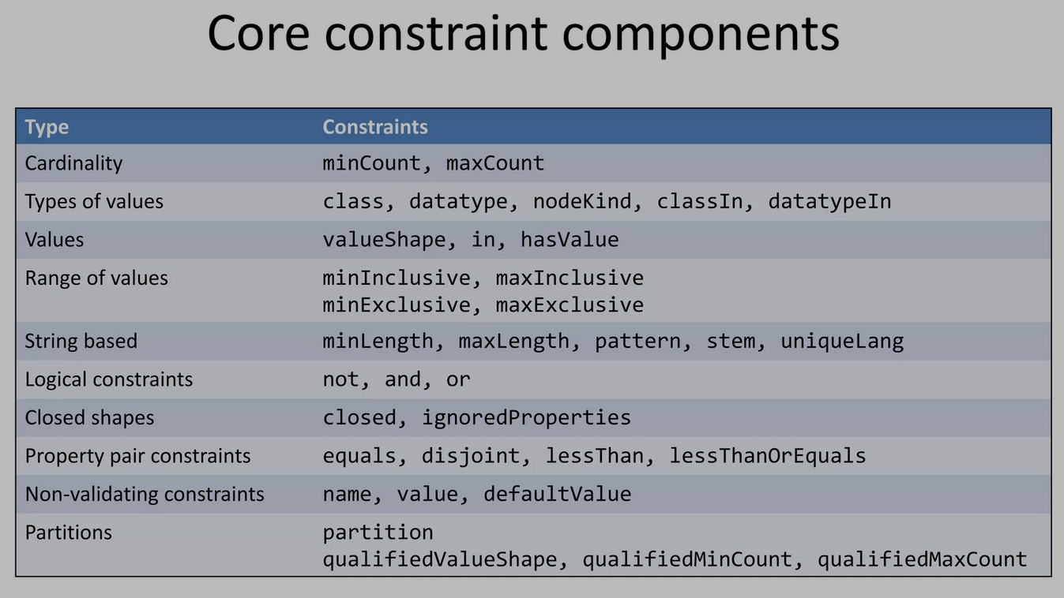

Slide 16
How SHACL processors return evaluations
Check the shape graph before validation of a data graph
Validation of a data Graph against a Shape Graph =
Union of the validations of each (focus) node in the data Graph against each constraint in the validation shape of these focus nodes (in the shape Graph)
Validation report (sh:ValidationReport)
Conforms: sh:conforms
Result : sh:result
Sh:shapesGraphWellFormed
Validation result (sh:ValidationResult)
Sh:focusNode, sh:resultPath; sh:value, sh:detail, sh:sourceConstraintComponent, sh:resultSeverity, sh:resultMessage

Slide 17
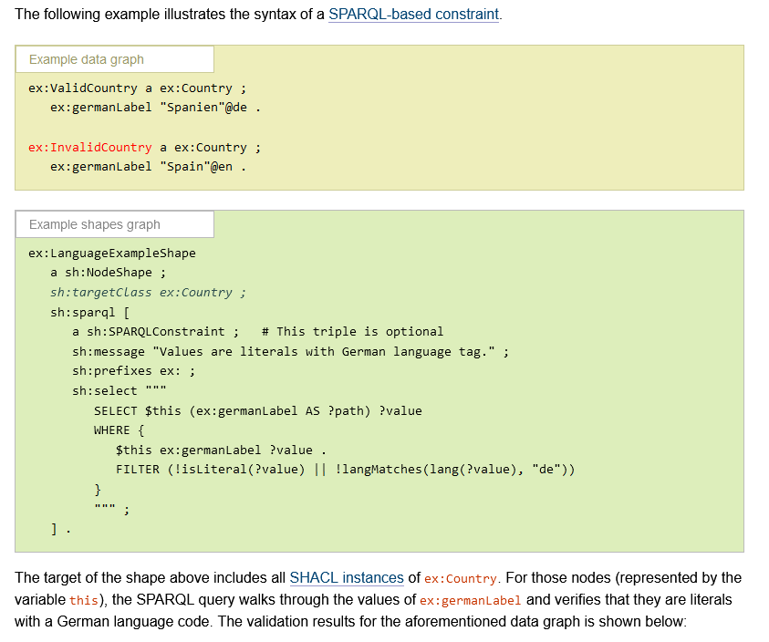
Further readings … SPARQL-based constraints https://www.w3.org/TR/shacl/#sparql-constraints

Slide 18
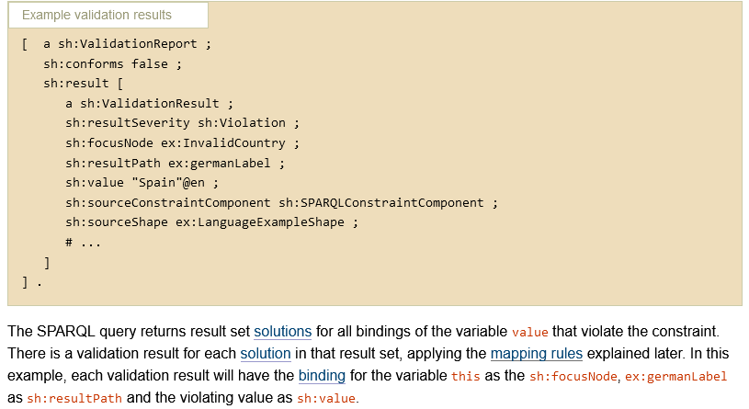
Example of result

Slide 19
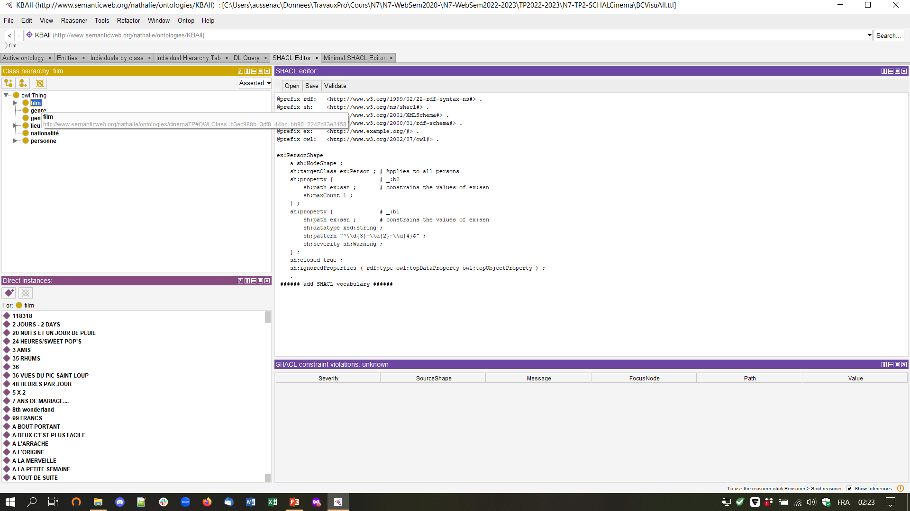
SHACL in Protégé: SHACL4Protégé

Slide 20
The target KG: presentation
BCVisuAll.ttl
Ontologie du cinéma
Nombreuses instances de films

Slide 21
TP questions (45 mn)
SHACL :
Write a shape testing that each person has a label
Write a shape for testing that all the instances of « long métrage » and « court métrage » satisfy the constraint about the film duration
Write a shape that constraints a film to be a « film populaire » only if it has a « note » superior to « 6,0 » (expect counstraint violations because the popularity is defined at a lower « note » in the ontology)
Write a shape that checks that a movie has at least 1 and at most 2 « genre »
Write a shape to check if each film is either a « long métrage » or a « court métrage »

Slide 22
Part 2 – SPARQL and SPARQL Update
SPARQL Query : https://www.w3.org/TR/rdf-sparql-query/
SPARQL Update : https://www.w3.org/TR/sparql11-update/
SPARQL is a query language that allows the user to query a RDF graph.
SPARQL Update is an extension allowing to update the knowledge graph using queries.
The goal of this part will be to write SPARQL queries in order to rectify the violations found in part 1.

Slide 23
SPARQL in Protégé
Unfortunately, Protégé doesn’t allow to run Update queries. Thus we will have to tinker in order to be able to use it.
The CONSTRUCT query is structured in the same way as the queries used to insert or remove data from a graph.
We will write CONSTRUCT queries inside Protégé, and the displayed triples will be the triples that should have been inserted/deleted.

Slide 24
SPARQL in Protégé
In Protégé, open the SPARQL Query Tab to be able to query the ontology. Write the following requests as CONSTRUCTs :
- Add a label « Unknown label » for all realisators who don’t have one
Remove the ‘Note’ for all popular movies who have a ‘Note’ under 5.
Add as label for each movie that doesn’t have one the last portion of its URI (after '\#').
Remove one random ‘Genre’ for each movie which has more than two.
Bonus : Edit the previous request so that it removes just the right amount of ‘Genre’ so that only two remain.

